Slide 1



Slide 2


Website:
www.https://learningandearningschool.com/register/
Mail:
contact@learningandearningschool.com
Head Office:
Learning & Earning School Ltd.
Yeasin Nagar (Maddha Barera), Bypass Moor, Mymensingh, Bangladesh

Slide 3

Legal Documents

Slide 4

DOCUMENTS

Slide 5


DOCUMENTS

Slide 6

WHAT IS LEARNING & EARNING SCHOOL?
Learning & Earning School Ltd. একটি আধুনিক অনলাইন ও অফলাইন সামাজিক ব্যবসা ভিত্তিক শিক্ষা প্ল্যাটফর্ম, যেখানে সীমাহীন শিক্ষার্থী একসাথে দক্ষতা অর্জন, অনুশীলন ও বাস্তব প্রয়োগের মাধ্যমে শেখে এবং আয়ের প্রায় ৮০% শিক্ষার্থী ও প্রমোটারদের মধ্যে ভাগ করা হয় — শেখা ও আয়ের সম্ভাবনা একসাথে।

Slide 7


Learning & Earning School Ltd.

Slide 8
🎯 Our Mission:
Learning & Earning School Ltd. - প্রতিটি শিক্ষিত মানুষকে অনলাইন প্রশিক্ষণের মাধ্যমে পেশাগত ভাষা, ডিজিটাল সচেতনতা এবং আয়-উপযোগী দক্ষতায় গড়ে তুলতে প্রতিশ্রুতিবদ্ধ। আমরা বিশ্বাস করি — শিক্ষা তখনই পূর্ণতা পায়, যখন তা মানুষের আয়, আত্মনির্ভরতা ও পেশাগত উন্নতির পথ তৈরি করে।

Slide 9

Learning & Earning School Ltd.

Slide 10
🎯 Our Vision:
Learning & Earning School Ltd. - এর লক্ষ্য হলো এমন অফলাইন স্কুল তৈরি করা, যেখানে সকল শিক্ষিত ও বেকার মানুষ বিশ্বব্যাপী জনপ্রিয় সার্টিফিকেট কোর্সসহ প্রয়োজনীয় দক্ষতা শিখে আত্মনির্ভর হবে, দেশের ও বিদেশের কর্মসংস্থানে যুক্ত হবে, বেকারত্ব কমবে এবং বাংলাদেশ অর্থনৈতিকভাবে সমৃদ্ধ হবে।

Slide 11
Learning & Earning School Ltd. -
💡 Tagline:
“From Education to Profession — Learn to Earn.”
💡 মূল বার্তা :
“শিক্ষা থেকে পেশা — শেখার সঙ্গে আয়ের সুযোগ।”

Slide 12
COURSE # 1500 BDT
Digital Marketing for Freelaning
Spoken English
01. Introduction to Digital Marketing
02. Market & Audience Research
03. Meta Marketing (FB & Instagram)
04. Marketing Content Materials
05. Google My Business (Local SEO)
06. SEO (Search Engine Optimization) 07. Email & ChatGPT Marketing
08. YouTube Marketing & Video SEO
09. LinkedIn & Personal Branding
10. Freelance Marketplace & Portfolio 11. Client Management Practice
12. Payment Gateway & Final Project
01. Basic Grammar Foundations
02. Essential Sentence Structure
03. Practical Speaking Skills
04. Question Formation Techniques
05. Everyday Conversation Mastery
06. Listening & Understanding Practice
07. Confidence & Fluency Development
08. Tense-Based Speaking Structure
09. Common Speaking Expressions
10. Topic-Based Monologue Practice
11. Professional Presentation Skills
12. Advanced Communication Techniques

Slide 13
COURSE # 1000 BDT
Computer Operation
1. Computer Fundamentals & Basic Operations
2. Operating System (Windows) Management
3. Typing Skills & Productivity Tools
4. Microsoft Word (Document Processing)
5. Microsoft Excel (Data Management & Analysis)
6. Microsoft PowerPoint (Presentation Skills)
7. Internet Browsing & Online Safety
8. Email & Digital Communication
9. File Management & Cloud Storage
10. Basic Graphic Design (Canva/Tools)
11. IT Troubleshooting & Maintenance Basics
12. Freelancing & Online Work Fundamentals

Slide 14
COURSE # 500 BDT
Digital Marketing with SMM
English for Work
1. Introduction to Digital Marketing & SMM
2. Market Research & Audience Targeting
3. Branding & Social Media Positioning
4. Social Media Platforms Overview
5. Business Profile Setup & Optimization
6. Content Strategy & Planning
7. Content Creation & Copywriting
8. Video Marketing (Reels, Shorts & YouTube)
9. Organic Social Media Growth Strategy
10. Paid Advertising (Meta Ads)
11. Lead Generation & Sales Funnel
12. Analytics & Performance Tracking
1. Workplace English Basics
2. Professional Communication
3. Office Etiquette & Team Skills
4. Workplace Speaking Skills
5. Listening & Understanding
6. Business & Industry Vocabulary
7. Email & Business Writing
8. Meetings & Presentation Skills
9. Phone & Virtual Communication
10. Client Handling & Service
11. Interview & Career Skills
12. Advanced Communication & Problem Solving

Slide 15
COURSE # 500 BDT
Entrepreneurship Development
1. Entrepreneurship Mindset
2. Business Opportunities
3. Business Planning & Strategy
4. Startup Legal Framework
5. Financial Management
6. Marketing & Branding
7. Digital Marketing Tools
8. Operations & Supply Chain
9. Risk & Problem Solving
10. Leadership & Team Skills
11. Funding & Investment
12. Business Growth & Sustainability

Slide 16






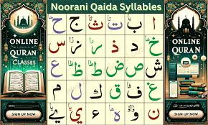

Upcoming Course:
Graphic Design
Kids Spoken
Arabic Language
Japanese Language
Spanish language
Korean Language
Noorani Quran Shikkah

Slide 17
Teacher
Hub
PORTAL
Job
Portal

Slide 18
UPCOMING PROJECT
Top 10 Most Globally In-Demand Practical Skills / Jobs
Skill / Job Global Demand Reason

Slide 19



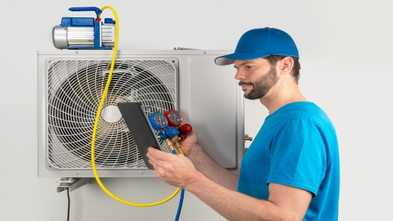


OFFLINE COURSE
Electrician / Electrical Technician
Plumbing & Pipe Fitting Technician
Construction & Welding Technician
HVAC / Cooling & Heating Technician
Professional Driver (LMV/HMV)

Slide 20






OFFLINE COURSE
Housekeeping & Caregiving Assistant
Hospitality & Tourism Professional
Computer Operator & Freelancing
Tailoring & Dress Making Professional
Beauty Therapy & Salon Professional

Slide 21
Why Learning & Earning School?
“Successful people do the same work in different ways”
(সফল ব্যাক্তিরা একই কাজ ভিন্ন ভিন্ন ভাবে করে)

Slide 22
Traditional
System
EXAMPLE
ONLINE
system

Slide 23



Traditional
System
Course costs: ৳10,000
3 month’s accommodation
and meals cost:৳20,000
Total = ৳30,000

Slide 24



ONLINE
system
Online course is only ৳500/1000/1500
12 class (weekly)
Validity: 180 days
Certification

Slide 25
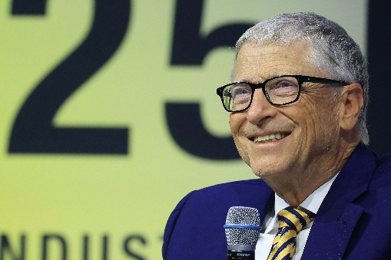

Bill Gates
EXAMPLE
Jeff Bezos

Slide 26

EXAMPLE
-Elon Musk
The World’s First Trillionaire (Projected)

Slide 27
Passive Earning

Slide 28
REWARD
Auto Trainee Allowance
2%
💰 New Enrolment
(500,1000,
1500৳ Fee)
📊 2% Allowance Generated
(10,20,30৳)
👨‍🎓 Equal Distribution
Among 2000 Trainees
⚙️ Micro Share per Trainee
≈ 0.001৳
✅ Stops Automatically
at 1500৳ Earned

Slide 29


Pool | Reward
66.67
Pool1
200 BDT
44.44
400 BDT
Pool2
(200)
Pool3 | 800.00BDT
Community Auto Pool
Pool4 | 1,600.00BDT
Pool5 | 3,200.00BDT
1:3
Pool6 | 6,400.00BDT
Left
REWARD
1
Pool7 | 12,800.00BDT
to
Right
Pool8 | 25,600.00BDT
Pool9 | 51,200.00BDT
Pool10 | 102,400.00BDT
66.67
2
200
66.67
3
200
66.67
4
200
Pool11 | 204,800.00BDT
Pool12 | 409,600.00BDT
Pool13 | 819,200.00BDT
Pool14 | 1,638,400.00BDT
Pool15 | 3,276,800.00BDT
Total=65,53,200BDT

Slide 30
Active Earning

Slide 31
Affiliate Program
30/30/40%
Affiliate Earning
22/21/30%
Reference Earning
8/9/10%

Slide 32


COURSE # 1500 BDT
10%
Reference Earning
Reference Earning = 10%;
1500x8% = 150TK;
10x150= 1500TK.
Team Work
Reference
Affiliate Earning 33.33%
Earn
Total Earning
Team-01
10
3.33%
10x50
500
Team-02
100
4.67%
100x70
7000
Team-03
1000
4%
1000x60
60000
Team-04
10000
3.33%
10000x50
500000
Team-05
100000
2.67%
100000x40
4000000
Team-06
1000000
2%
1000000x30
30000000
Team-07
10000000
1%
10000000x15
150000000
Team-08
100000000
1%
10000000x15
1500000000
Team:09-10=0.67%=10TK.
Team:11-30=0.33%=5TK.

Slide 33
COURSE # 1000 BDT
9%
Reference Earning
Reference Earning = 9%;
1000x9% = 90TK;
10x90= 900TK.
Team Work
Reference
Affiliate Earning 24%
Earn
Total Earning
Team-01
10
1.5%
10x15
150
Team-02
100
3%
100x30
3000
Team-03
1000
2.5%
1000x25
25000
Team-04
10000
2%
10000x20
200000
Team-05
100000
1.5%
100000x15
1500000
Team-06
1000000
1.5%
1000000x15
15000000
Team-07
10000000
1%
10000000x10
100000000
Team-08
100000000
1%
10000000x10
1000000000
Team:09-10=0.5%=5TK.
Team:11-30=0.3%=3TK.

Slide 34
COURSE # 500 BDT
8%
Reference Earning
Reference Earning = 8%;
500x8% = 40TK;
10x40= 400TK.
Team Work
Reference
Affiliate Earning 23%
Earn
Total Earning
Team-01
10
2%
10x10
100
Team-02
100
3%
100x15
1500
Team-03
1000
2.4%
1000x12
12000
Team-04
10000
2%
10000x10
100000
Team-05
100000
1.8%
100000x9
900000
Team-06
1000000
1.6%
1000000x8
8000000
Team-07
10000000
1%
10000000x5
50000000
Team-08
100000000
1%
10000000x5
500000000
Team:09-10=0.6%=3TK.
Team:11-30=0.3%=1.5TK.

Slide 35
Course 1500
Point # 3
Course 1000
Point # 2
RANK POINT
ONLINE
system
Course 500
Point # 1

Slide 36


Rank Point = 150 = (RC) = 3.33% = 50TK.
(3-RC)=JC
REWARD
Rank Royalty
9%
(3-JC)=C
3%
Incentives
(3-C)=SC
3%
(Rising Captain)
45
(Junior Captain)
3.33%
(3-SC)=EC
50
(Captain)
30
2%
(Senior Captain)
(3-EC)=PC
1.33%
(Elite Captain)
20
(Prime Captain)
(3-PC)=LC
0.67%
(Legendary Captain)
10
0.33%
0.33%
0.33%
0.33%
0.33%
(Galaxy Captain)
5
(3-LC)=GC
(Crown Captain)
0
(RC)
(JC)
(C)
(SC)
(EC)
(PC)
(LC)
(GC)
(CC)
(Incentives)
(3-GC)=CC

Slide 37
Rank Point =150 = (RC) = 2.5% = 25TK.
(3-RC)=JC
REWARD
Rank Royalty
8%
(3-JC)=C
2%
Incentives
(3-C)=SC
2%
(Rising Captain)
20
(Junior Captain)
2.5%
(3-SC)=EC
25
(Captain)
(Senior Captain)
(3-EC)=PC
15
1.5%
(Elite Captain)
(Prime Captain)
(3-PC)=LC
10
1%
(Legendary Captain)
0.5%
0.5%
0.5%
0.5%
0.5%
0.5%
(Galaxy Captain)
5
(3-LC)=GC
(Crown Captain)
0
(RC)
(JC)
(C)
(SC)
(EC)
(PC)
(LC)
(GC)
(CC)
(Incentives)
(3-GC)=CC

Slide 38
Rank Point =150 = (RC) = 2.8% = 14TK.
(3-RC)=JC
REWARD
Rank Royalty
7%
(3-JC)=C
1%
Incentives
(3-C)=SC
2%
(Rising Captain)
10
(Junior Captain)
2.8%
(3-SC)=EC
14
(Captain)
(Senior Captain)
(3-EC)=PC
6
1.2%
(Elite Captain)
(Prime Captain)
(3-PC)=LC
3
0.6%
(Legendary Captain)
0.4%
0.4%
0.4%
0.4%
0.4%
0.4%
(Galaxy Captain)
2
(3-LC)=GC
(Crown Captain)
0
(RC)
(JC)
(C)
(SC)
(EC)
(PC)
(LC)
(GC)
(CC)
(Incentives)
(3-GC)=CC

Slide 39

scouter
Scouter
Union Scouter
1.5%
Qualifications:
Rising Captain(R.C)
Got mail to be a scouter
Form-fill-up (Submit your details)
Approval depends on vacancy and activity
Facility
Balance transfer 0.5%
Scouter Pool 1%=5/10/15TK.

Slide 40
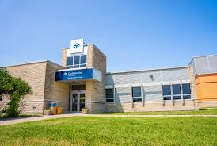
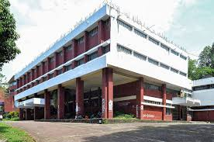
Campus introducer 1%
District Campus
0.5% (2.5/5/7.5TK)
Upazila Campus
0.5% (2.5/5/7.5TK)

Slide 41

CAMPUS EARNING 4%
School
Campus
Balance Transfer
0.5%
Deposit
0.25%
Enroll
0.5%
Pool
1%
Withdraw 2%
District Campus
2.5/5/
7.5
1.25/2.5/3.75
2.5/5/
7.5
5/10/15
20
1500
1500
Upazila
Campus
2.5/5/
7.5
1.25/2.5/3.75
2.5/5/
7.5
5/10/15
20
1500
ENROLL:1500
Withraw:1000
Student
Campus=Charge5%=D.C/U.C=2%
*(3%Institution)*
Digital Marketing
Spoken English

Slide 42
Student Withdraw
Once a student earns 100 BDT, they can withdrawals from school at 5% service charge. Example: 100 BDT × 5% = 95 BDT.
Students can withdraw from their district or upazila campus for only 5% BDT service fee.

Slide 43
🌟We’re excited to have you with us. Together, let’s grow, achieve, and make success happen! 🚀
Welcome to a New Journey!
Learning & Earning School Ltd.

